Slide 1
Logistic Regression
IUT AI Student Chapter

Slide 2


Classification
Given information about music
Classify the genre.
Given emails texts classify if it is
Spam or not.

Slide 3
Classification
Discrete labels
Binary classification y є {0, 1}
Positive class : y = 1 (spam)
Negative class : y = 0 (not spam)
Multiclass classification y є {0, 1, 2, …}

Slide 4
How to classify?
label
H(x) ≥ 0.5 ⇒ y = 1
H(X) < 0.5 ⇒ y = 0
What’s the problem?
Tumor size

Slide 5
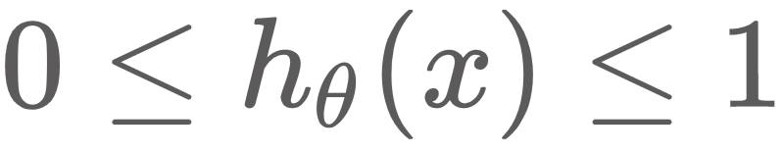
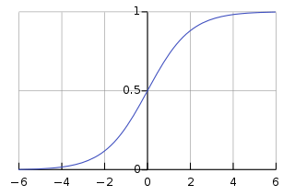
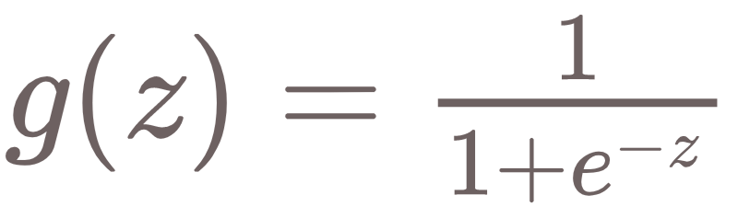
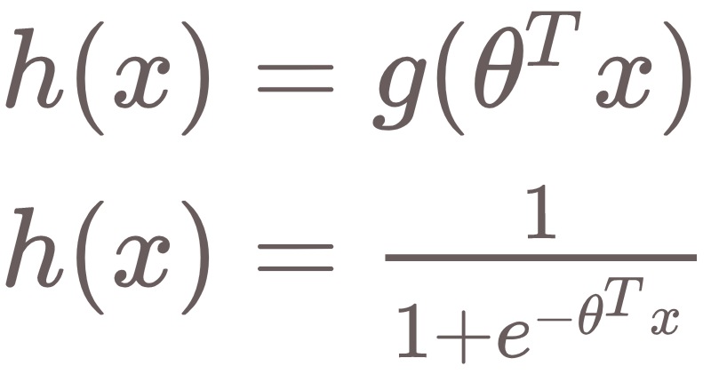
Logistic Regression
We need .
Let’s map h(x) between 0 and 1.
Sigmoid or Logistic
function

Slide 6
What does it mean?
If h(x) = 0.8 ⇒ the probability of the tumor being malignant is 80% !
⇒we are computing p(y =1 | x : θ)

Slide 7
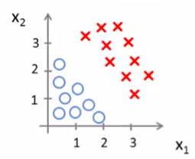
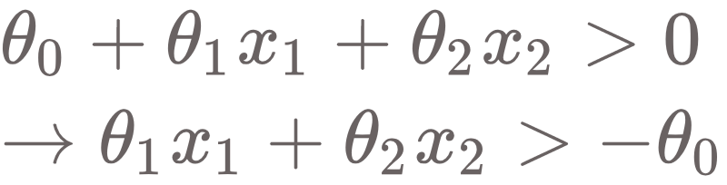
Decision Boundary
g(z) > 0.5 ⇒ z > 0
g(z) < 0.5 ⇒ z < 0
⇒

Slide 8
Loss function
What about mean squared error?
It will work fine…
But it’s not convex
GD will probably not converge

Slide 9
Loss function
We need to change θ so that if y = 1 h(x) is as close as possible to 1
If y = 0 then 1-h(x) is as close as possible to 1
Let’s maximize the likelihood

Slide 10
Loss function

Slide 11

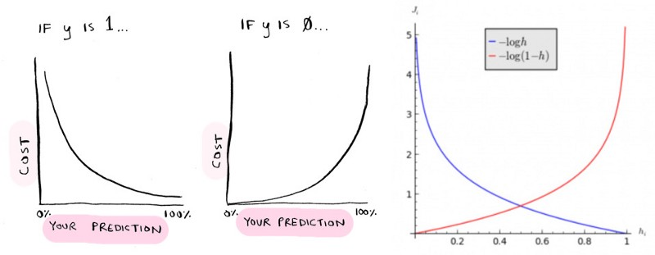

Loss Function

Slide 12
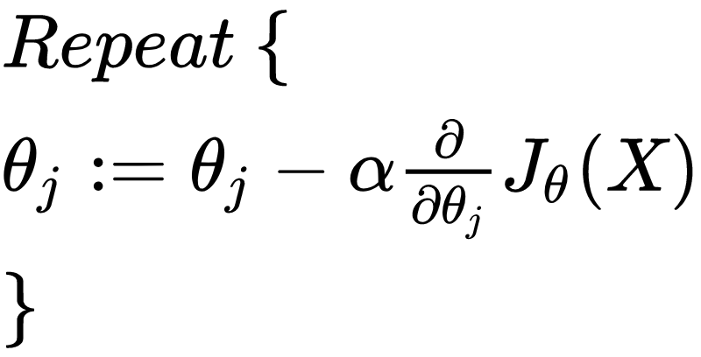
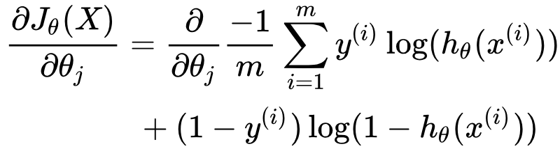
Gradient Descent
Where

Slide 13
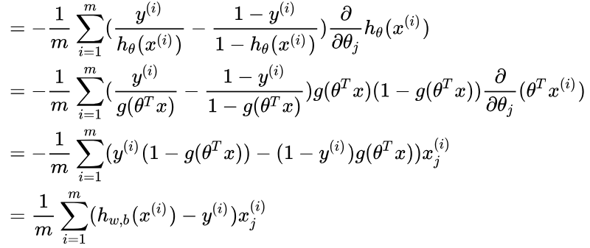

Slide 14
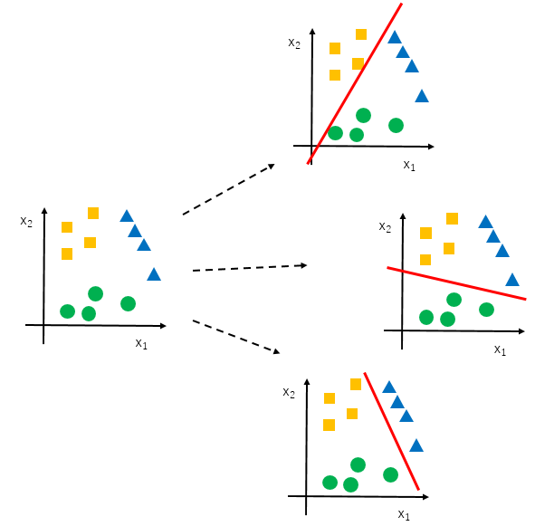
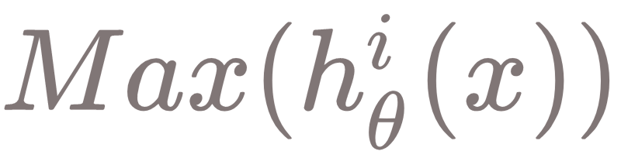
Multiclass Classification
Train Binary classifiers for each model
One vs all

Slide 15
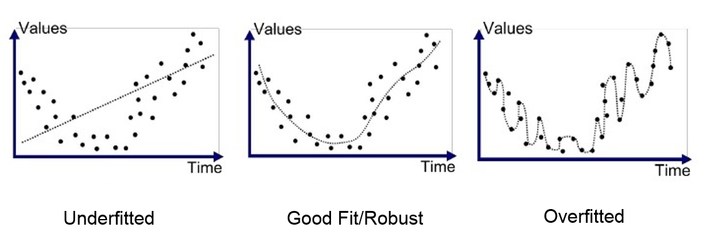
Overfit or underfit That’s the question
Consider a Regression problem :
High Bias
High Variance

Slide 16
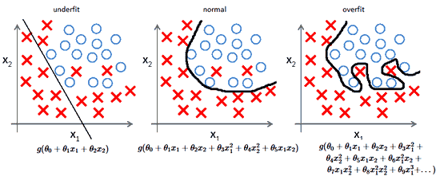
Overfit or underfit That’s the question
In a classification problem :

Slide 17
Overfit or underfit That’s the question
In a classification problem :

Slide 18
Overfit or underfit That’s the question
Overfitted model:
Can’t generalize well on novel samples
High accuracy on training samples
Underfitted model:
Can’t predict well on novel samples
Low accuracy on training samples

Slide 19
How to avoid overfitting?
L2 Regularization
ƛ is the regularization parameter
Penalize large coefficients
Gradients change too

Slide 20
Model Evaluation
IUT AI Student Chapter

Slide 21
Is Accuracy Enough?
Suppose we want to recognize if a tumor is “Malignant” or “benign”.
Our accuracy is 99% !
Only 1% of patients have cancer (skewed Classes)
Improvement in predicting y = 0 (benign) doesn't mean that our classifier is good.

Slide 22
Precision And Recall
True Positive: data points labeled as positive that are actually positive
False Positive: data points labeled as positive that are actually negative
False Negative: data points labeled as negative that are actually positive
True Negative: data points labeled as negative that are actually negative
Actual Class
Confusion Matrix | Positive | Negative
Positive
Negative
Predicted Class
True Positive
False Positive
False Negative
True Negative

Slide 23
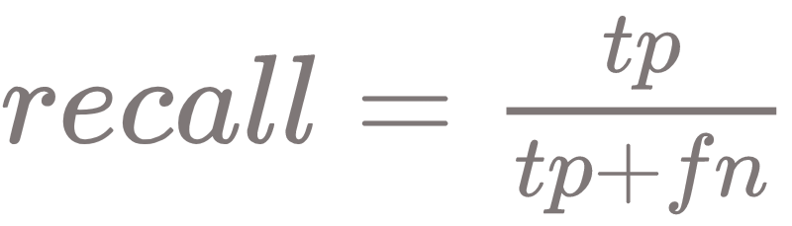
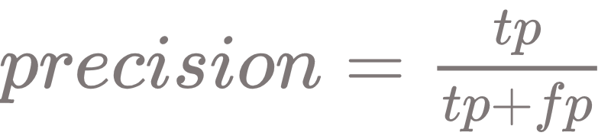
Precision And Recall
Recall: Of all patients that actually have cancer, what fraction did we correctly detect as having cancer?
Precision: Of all patients where we predicted y = 1, what fraction actually has cancer?

Slide 24
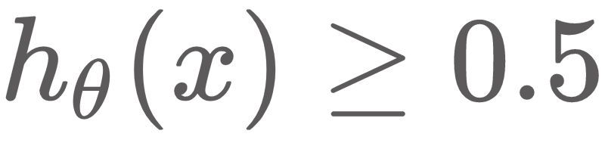
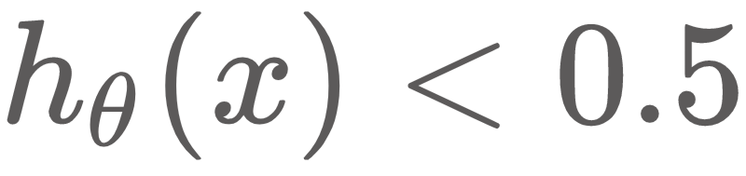
Trading Off Precision & Recall
From Logistic Regression we have
Predict 1 if
Predict 0 if
0.7
0.3
0.7
0.3
Suppose we want to predict y = 1 (cancer) only if confident Higher Precision, Lower Recall
Suppose we want to avoid missing too many cases of cancer Higher
Recall, Lower Precision

Slide 25
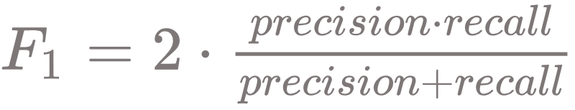
Trading Off Precision & Recall
 | Precision | Recall | Average | F1 Score
Algorithm 1 | 0.5 | 0.4 | 0.45 | 0.444
Algorithm 2 | 0.7 | 0.1 | 0.4 | 0.175
Algorithm 3 | 0.02 | 1.0 | 0.51 | 0.0392

Slide 26
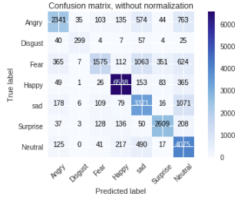
Confusion Matrix for Multiclass Classification

Slide 27
Novelty and Outlier Detection
IUT AI Student Chapter

Slide 28


Slide 29
Types of outliers
Univariate:
Univariate outliers can be found when looking at a distribution of values in a single feature space
Multivariate :
Multivariate outliers can be found in a n-dimensional space (of n-features)

Slide 30
Most common causes of outliers
Measurement error
Data entry error (human error)
Experiment error
Intentional (done on purpose of find how much out method is good)
Data processing errors
Natural (Novelty)

Slide 31
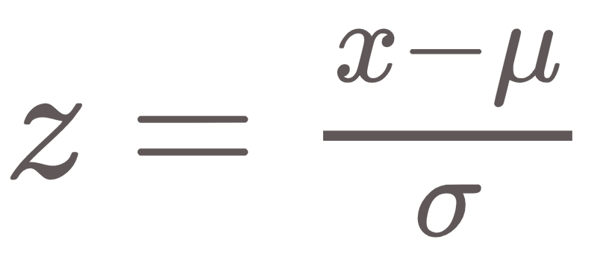
Z-Score
A method for Outlier Detection
Definition: The z-score or standard score of an observation is a metric that indicates how many standard deviations a data point is from the sample’s mean, assuming a gaussian distribution.
A parametric method for low dimensional feature space
Very frequently data points are not to described by a gaussian distribution Scale it

Slide 32
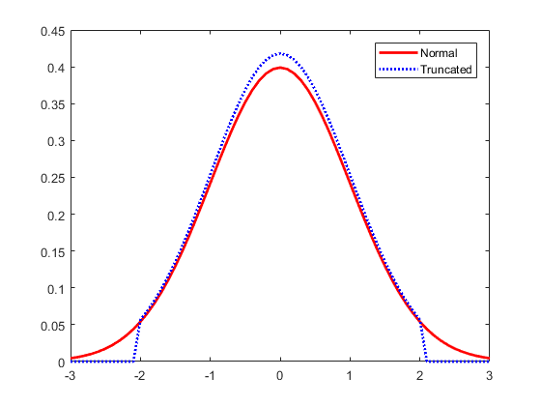
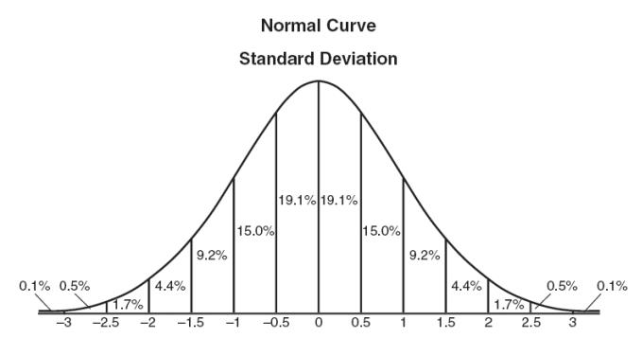
Z-Score
A method for Outlier Detection
Compare z-score of each point with a threshold: 2.5, 3, 3.5 or more standard deviations.

Slide 33
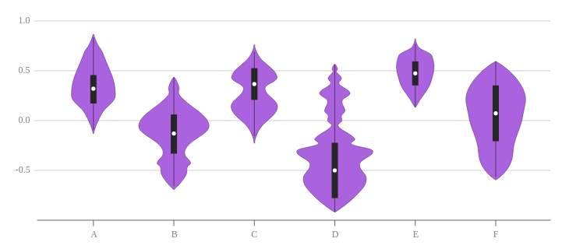
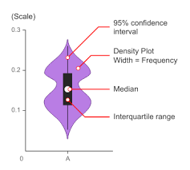
Another Method

